Slide 1
Project 5 Car Insurance
By Ahmed Asiri

Slide 2
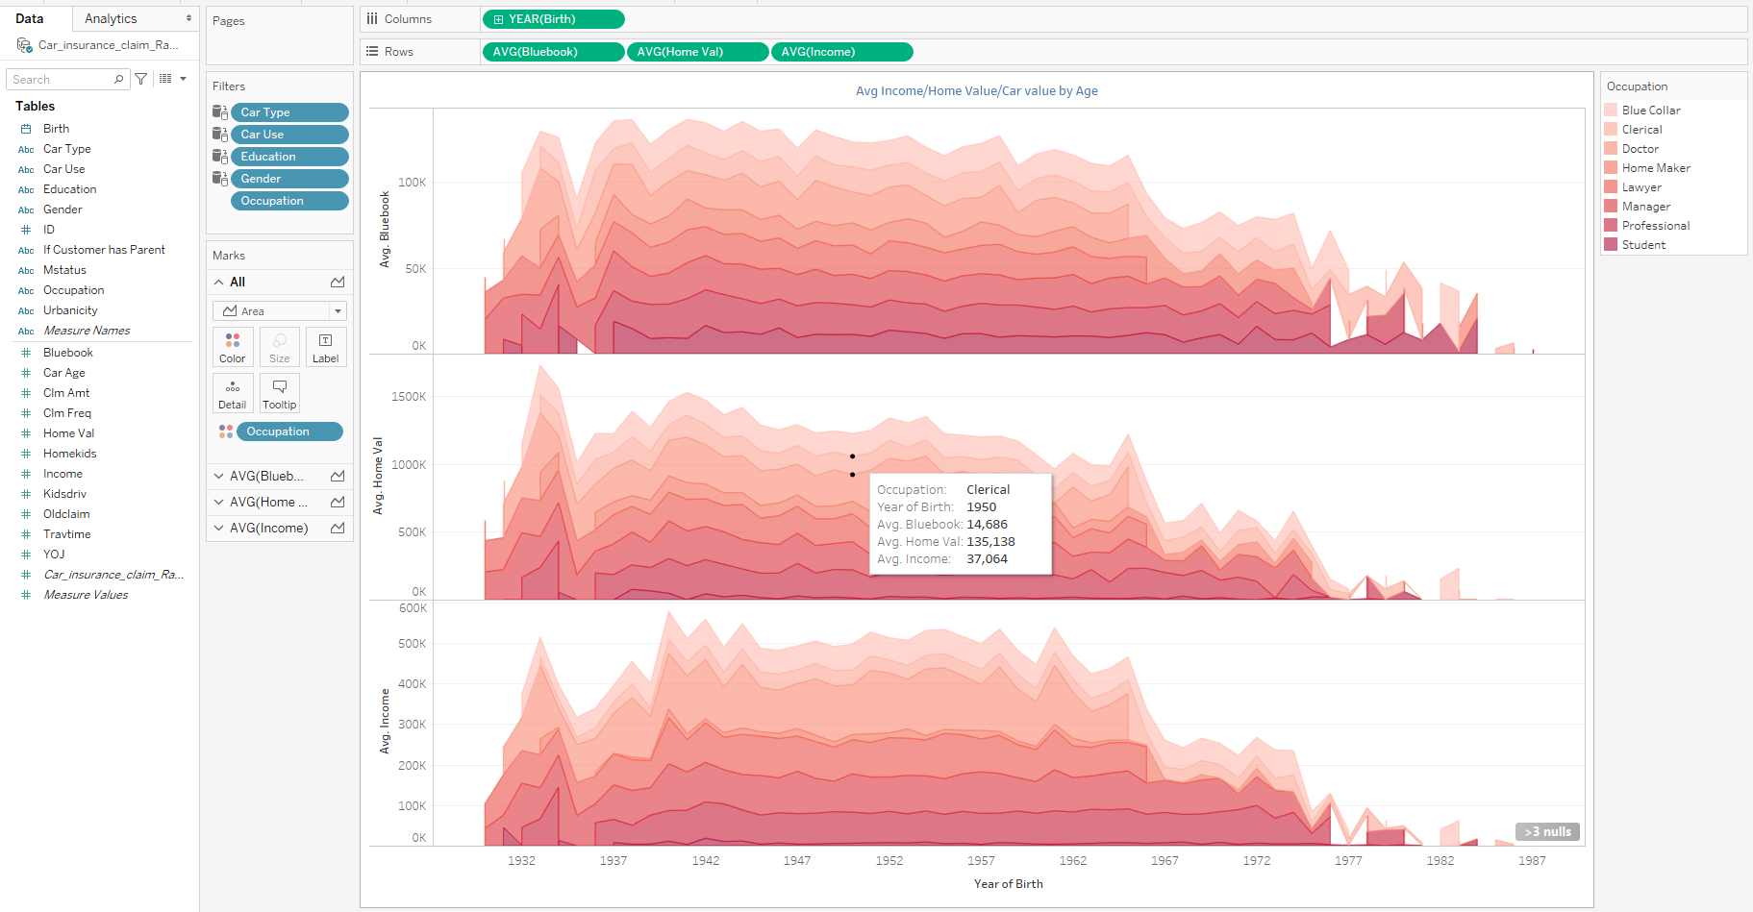
Avg Income/Home Value/Car value by Age

Slide 3
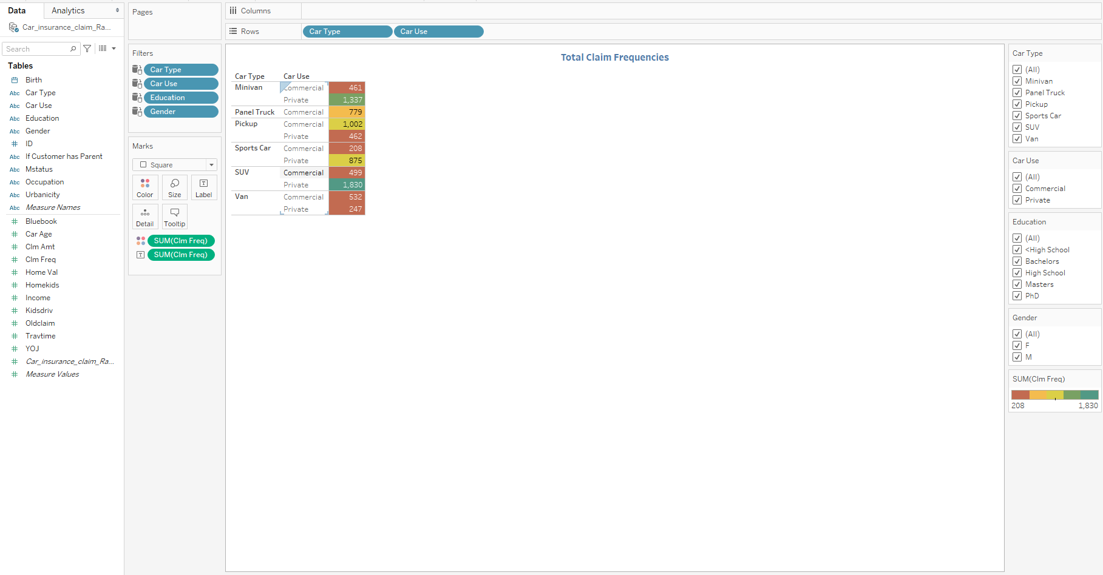
Total Claim Frequencies

Slide 4
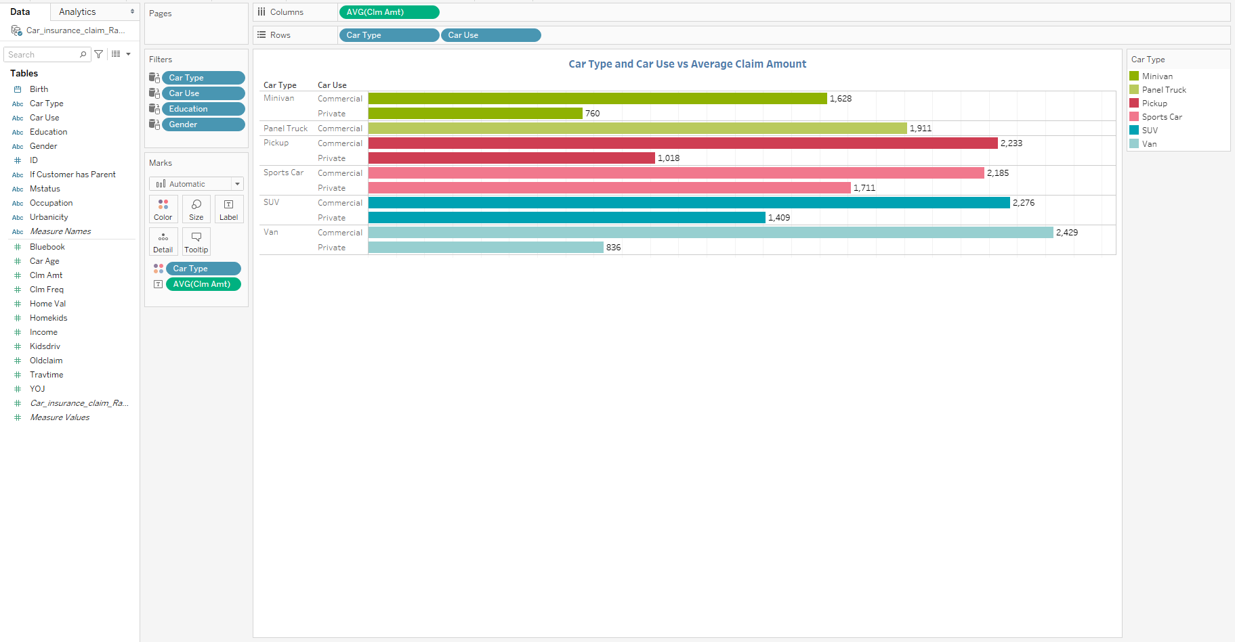
Car Type and Car Use vs Average Claim Amount

Slide 5
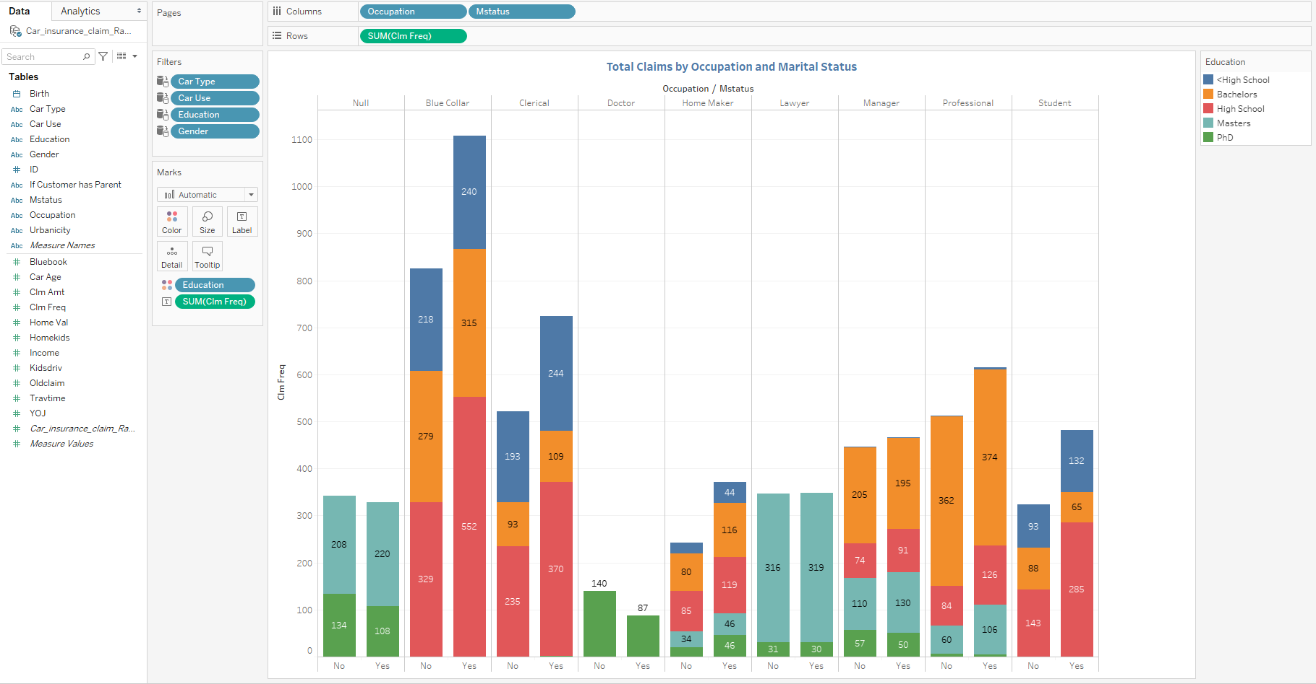
Total Claims by Occupation and Marital Status

Slide 6
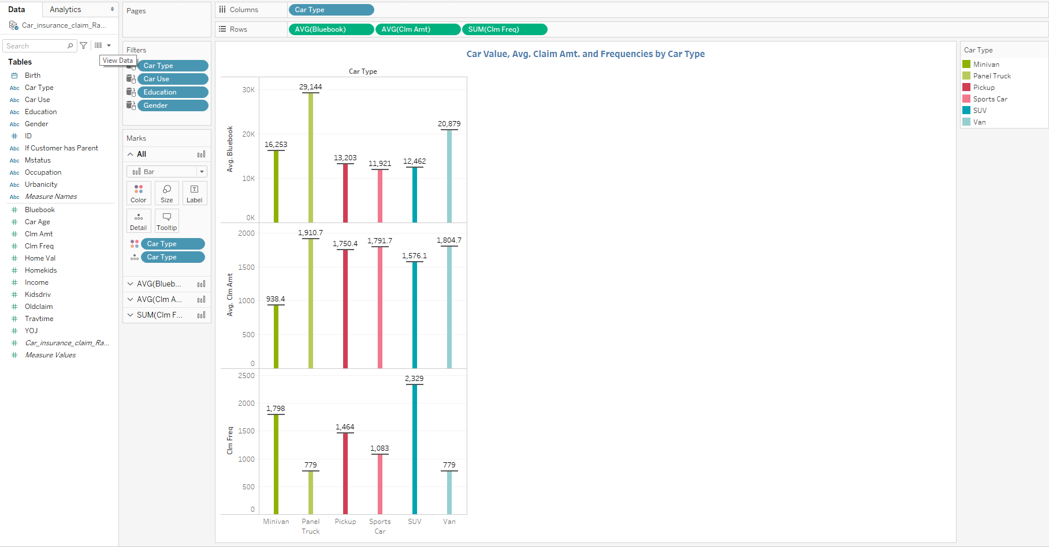
Car Value, Avg. Claim Amt. and Frequencies by Car Type

Slide 7
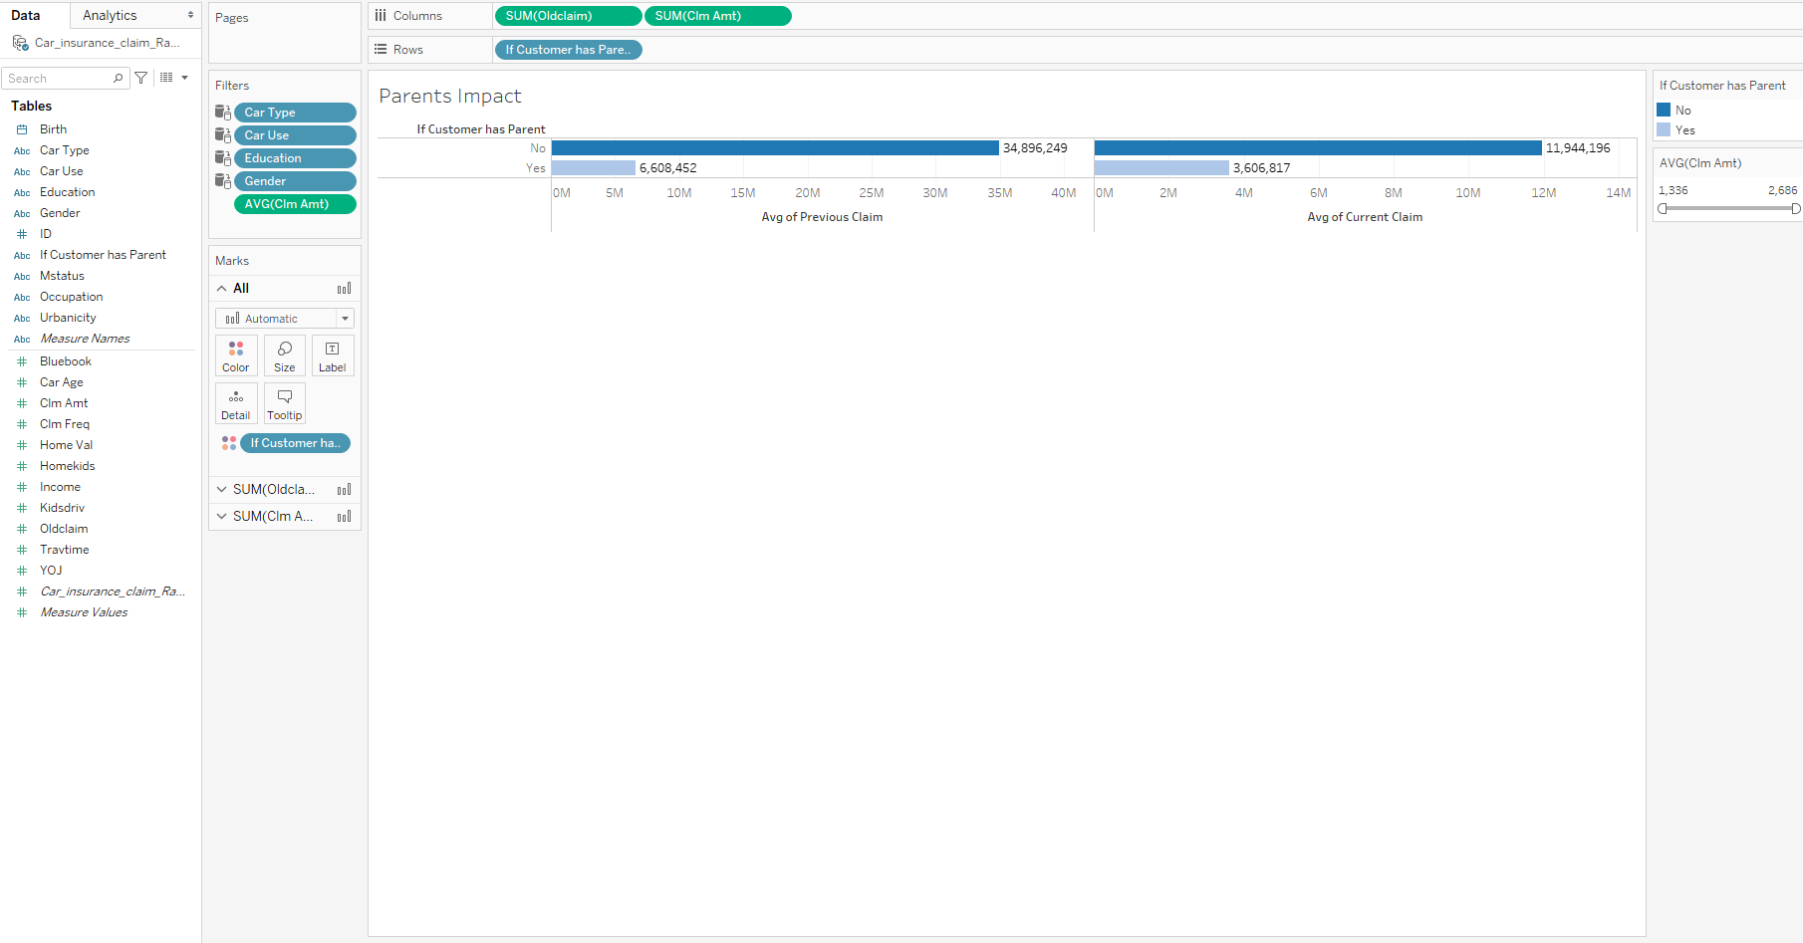
Parents impacts

Slide 8
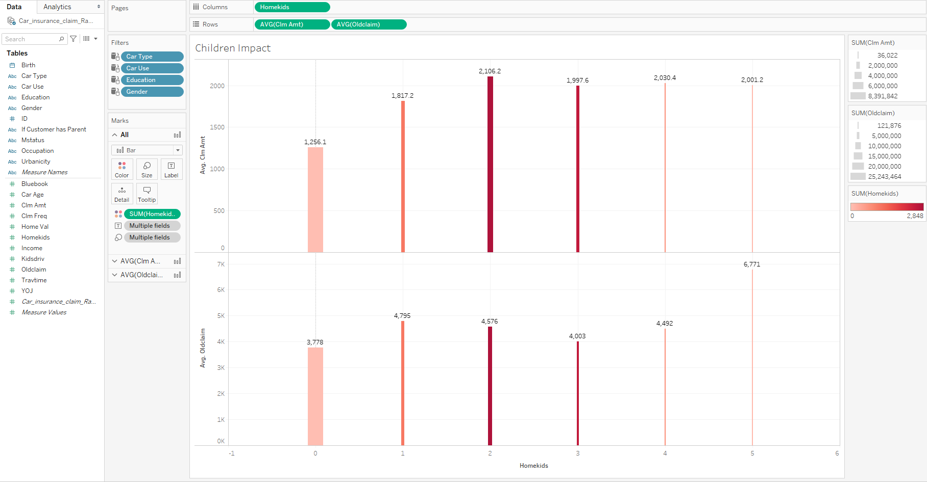
Children impacts

Slide 9
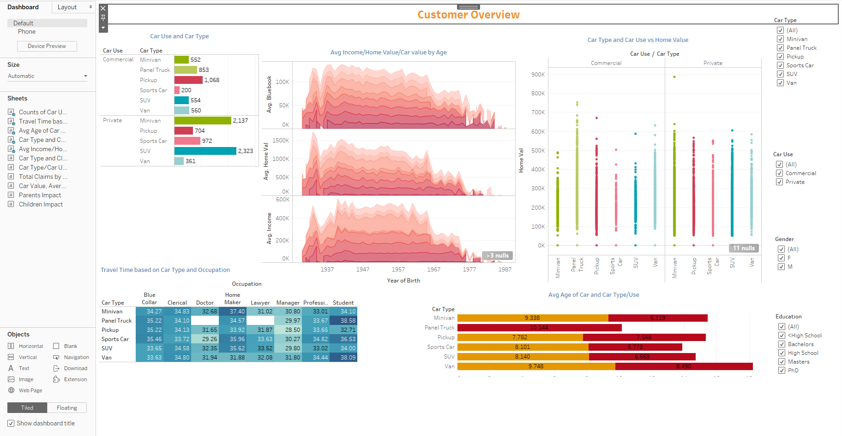
Customer Overview

Slide 10
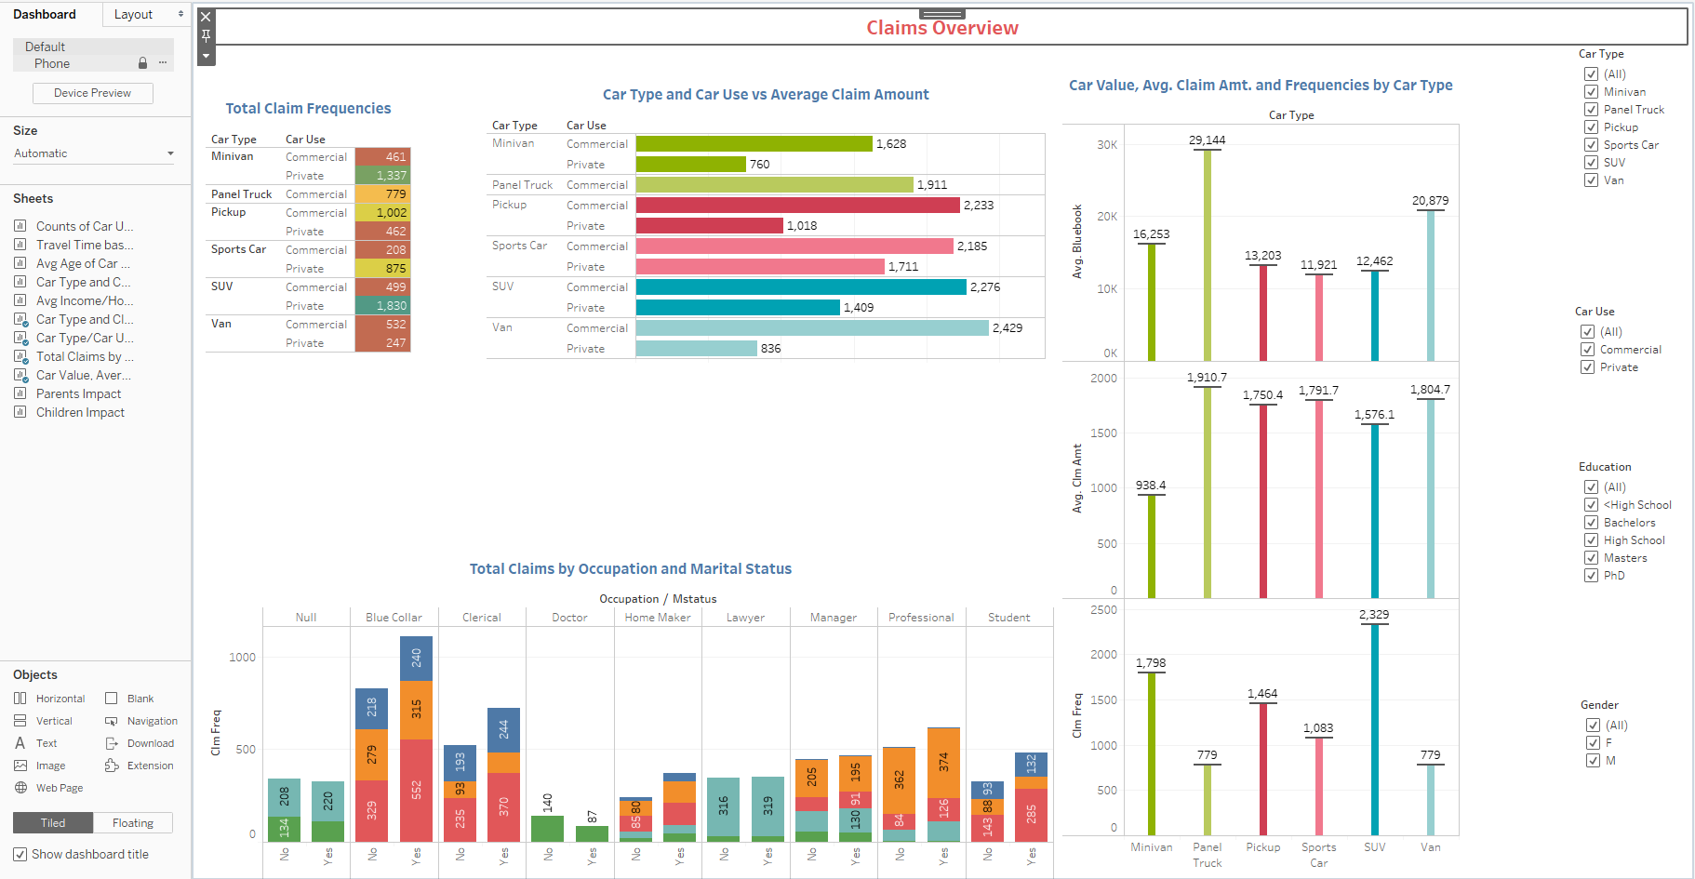
Claims Overview

Slide 11
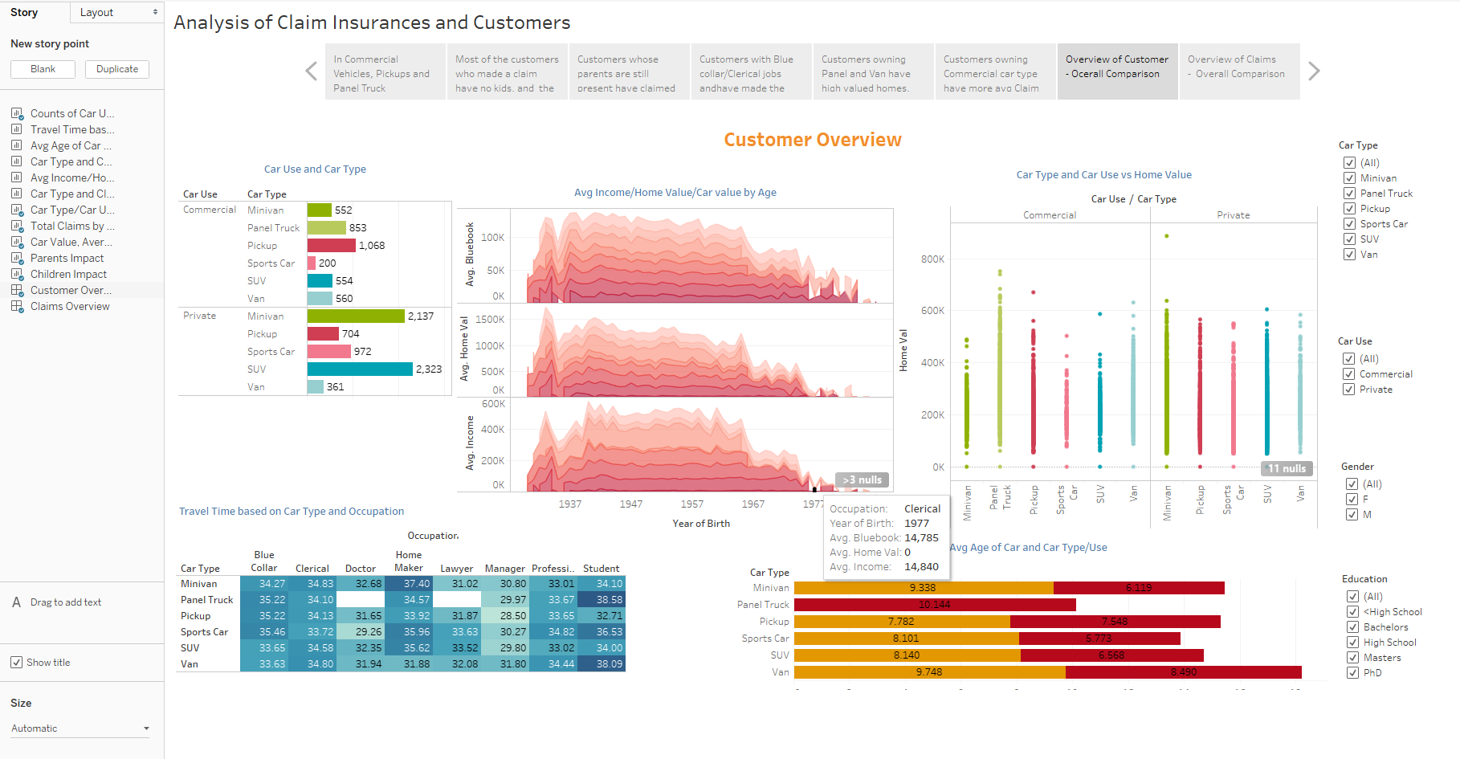
Analysis of Claim Insurances and Customers

Slide 12
Can be fount in the following URL
https://public.tableau.com/profile/ahmed.mohammed.hasan.asiri#!/vizhome/ClaimsInurance_15984266878940/AnalysisofClaimInsurancesandCustomers

Slide 13
Thank you

